Slide 1

Ez As Py News
Wednesday 12/07/2022
Adam Cooke, Isaiah Robinson, Nia Robinson
Edition: 001
“Get your daily slice of news with EAP News”

Slide 2

Elevator Pitch
Wednesday 12/07/2022
Adam Cooke, Isaiah Robinson, Nia Robinson
Edition: 001
On average people spend around 70-80 minutes a day consuming news.
With Ez As Py News, you have access to the most important news articles at your disposal and in one, easy, and convenient place.

Slide 3

Processes
Wednesday 12/07/2022
Adam Cooke, Isaiah Robinson, Nia Robinson
Edition: 001
Tech Used:
Github, Google Colab, Python, Gnews, Pandas, Streamlit, Web3, Ganache, Remix
Breakdown of tasks and roles
Pulled the data from Gnews, put it in DataFrames, cleaned it up by filtering unwanted columns.
Created a web interface using streamlit. Included the dataframes on individual tabs.
Created a smart contract that allows for the “minting” of certificates of membership, and creating an interface that can interact with the contract.
Challenges
Converting Gnews Json data into panda dataframes, contract integration with Web3.
Successes
Collected data from new library, streamlit configuration with tabs.

Slide 4

Demonstrations
Wednesday 12/07/2022
Adam Cooke, Isaiah Robinson, Nia Robinson
Edition: 001
This project consists of two streamlit applications. One for the user to purchase their certificate of membership, and the other for using the news services.

Slide 5
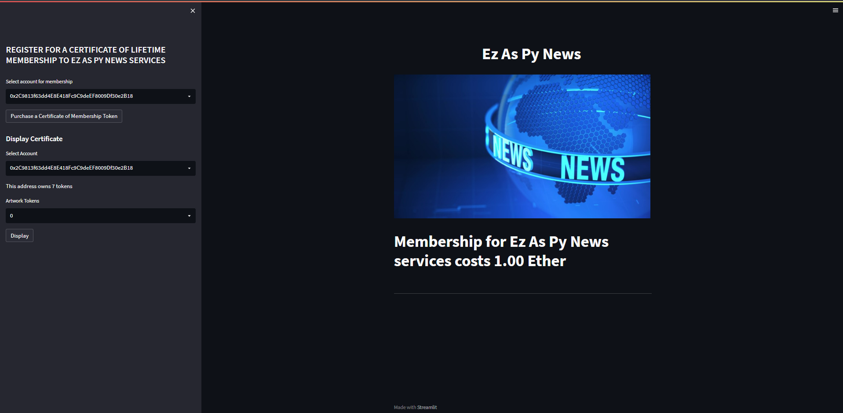

Slide 6
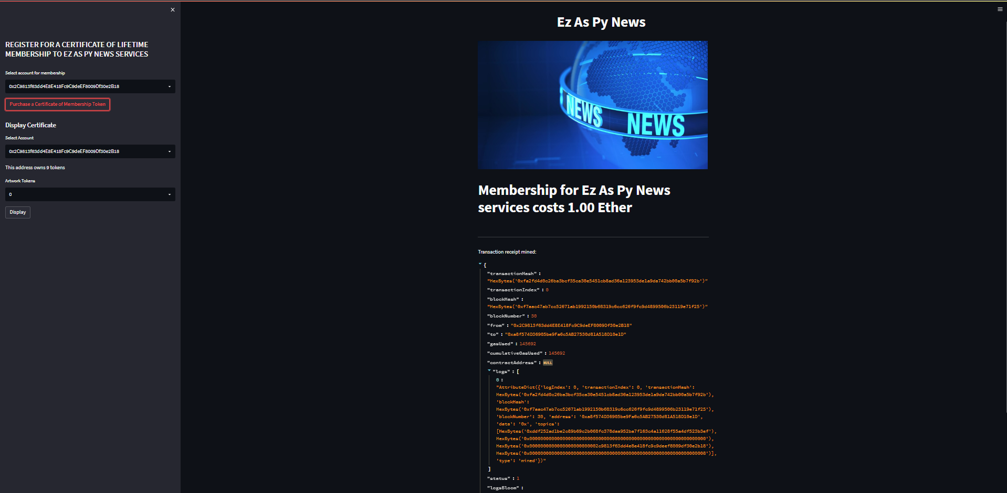

Slide 7
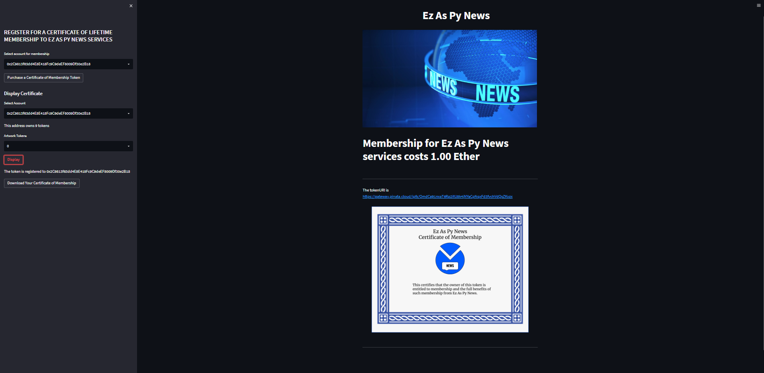

Slide 8
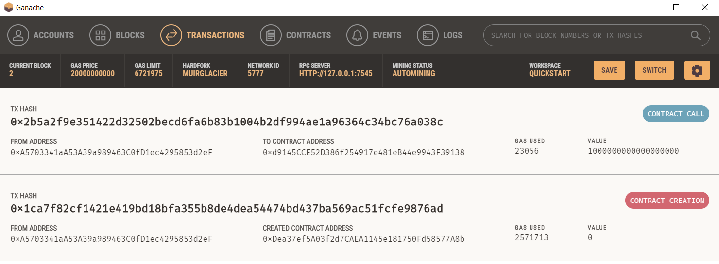

Slide 9
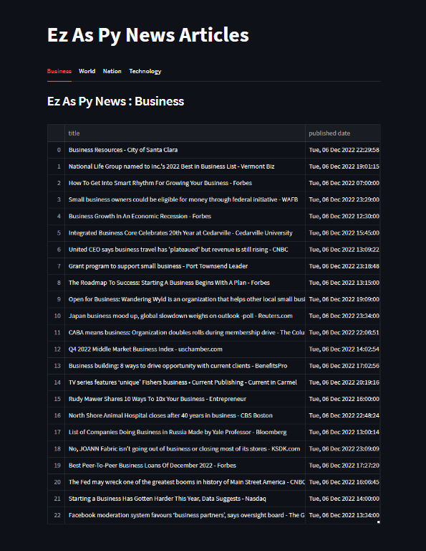

Slide 10
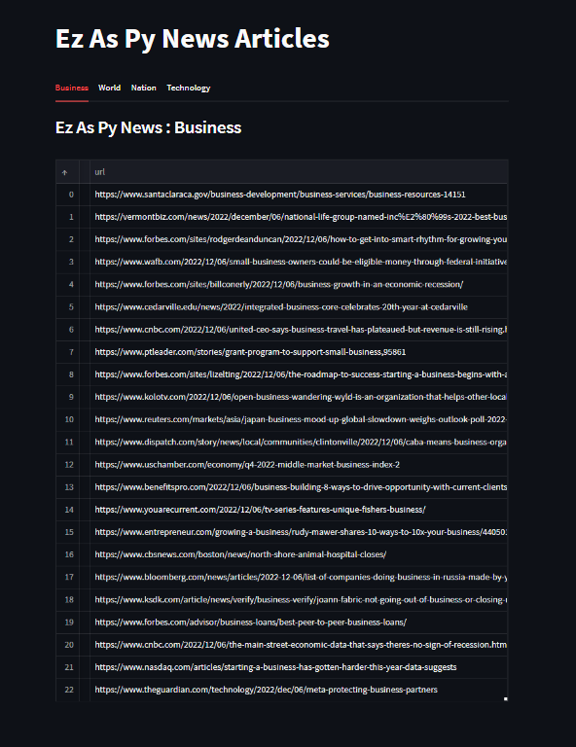

Slide 11
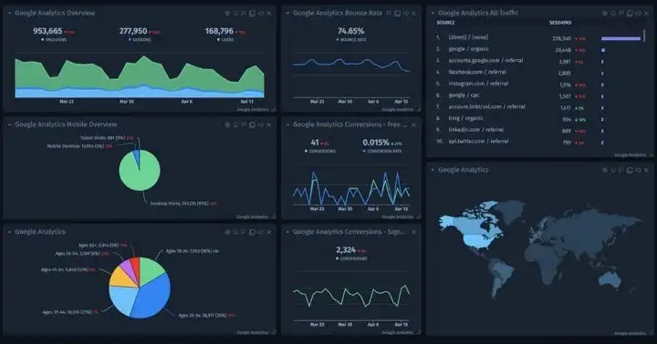
Future Development / Next Steps
Wednesday 12/07/2022
Adam Cooke, Isaiah Robinson, Nia Robinson
Edition: 001
Dashboard widgets displaying financial statistics and trends
Search capability that requires user input
Search by Topic filters
App Login (username/password) connected to Membership Token and then re-routes to news articles and dashboard
Scale membership subscriptions (lifetime, yearly, monthly, weekly)

Slide 12

Links
Wednesday 12/07/2022
Adam Cooke, Isaiah Robinson, Nia Robinson
Edition: 001
GitHub: https://github.com/AdamCooke22/project_3
GNews: https://pypi.org/project/gnews/
Remix: https://remix-project.org/
Ganache: https://trufflesuite.com/docs/ganache/quickstart/
ERC-721: https://docs.openzeppelin.com/contracts/4.x/erc721
Counters: https://docs.openzeppelin.com/contracts/4.x/api/utils#Counters
Streamlit: https://streamlit.io/

